Slide 1
Notes:
Hello, I am a master student at the technical university of Berlin and a research assistant at Max-Born-Institut and would like to tell you how we do magnetic scattering with soft-x-ray in our lab at Max-Born-Institut.

Slide 2
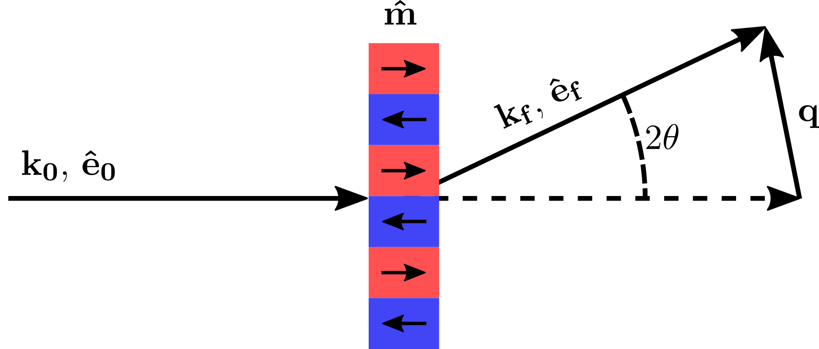
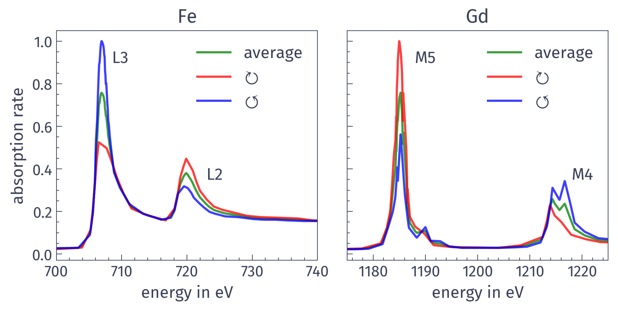
Soft X-ray to study magnetism
[Fe (0.4 nm)|Gd (0.5 nm)]×116
Small angle X-ray scattering (SAXS)
Fourier-Transform
X-ray Magnetic Circular Dichroism (XMCD) effect
Absorption rate depends on mutual orientation of spins and polarisation and light
Element selective due to narrow resonant peaks
Scattering is possible with non polarized light
Notes:
We have a sample we are interested in. This is iron gadolinium superlattice which exhibits magnetic domains with out of plane magnetization. How can we study it?
With this periodic structure some kind of scattering techniques would be useful. But to do so we need some magnetic contrast.
Here the the x-ray magnetic circular dichroism (shorten XMCD) effect come into play. It basically means that the absorption of the photon is dependent of mutual orientation of electron spin and photon polarization. This effect is especially pronounced at L2,3 edges of transition metals and M4,5 of rare-earth metals. Important note is that the scattering with XMCD does not require the light to be polarized. The edges for iron and gadolinium are narrow and lie far from each other what allows us to perform element selective analysis. The both edges though lie in soft-x-ray range, so we need to have a source of soft-x-ray radiation.

Slide 3
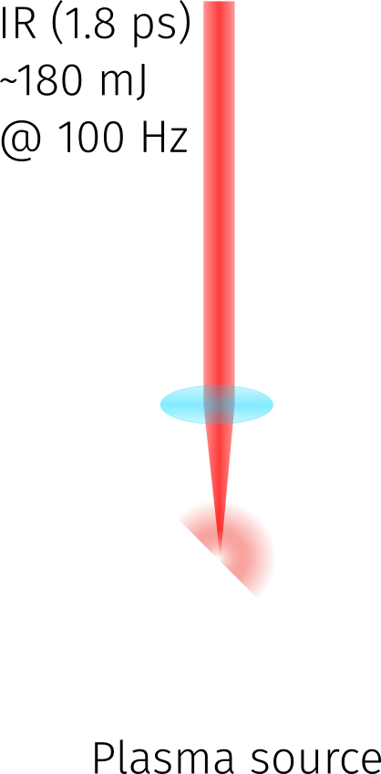
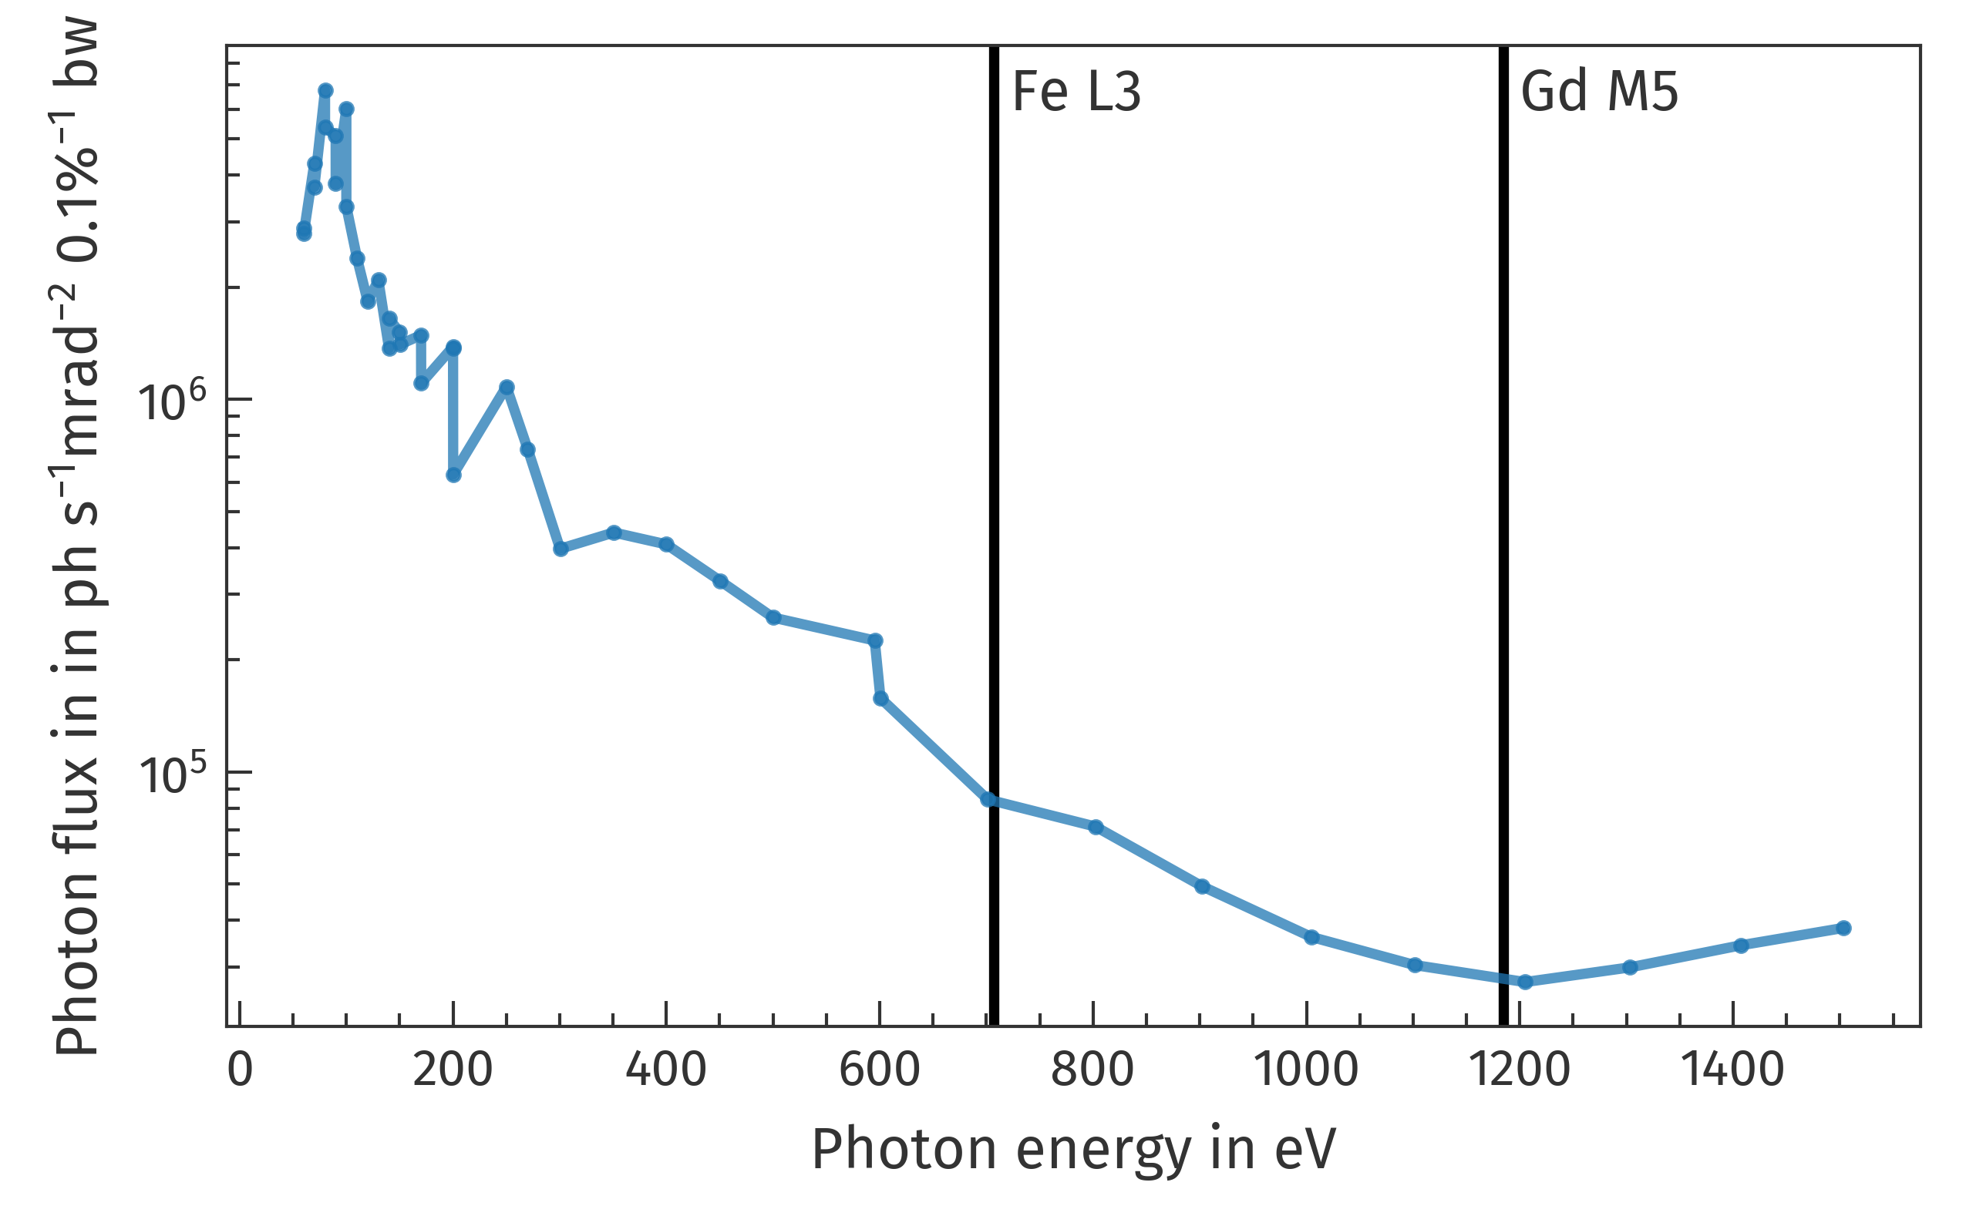
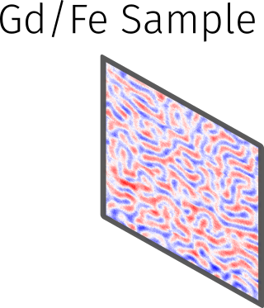
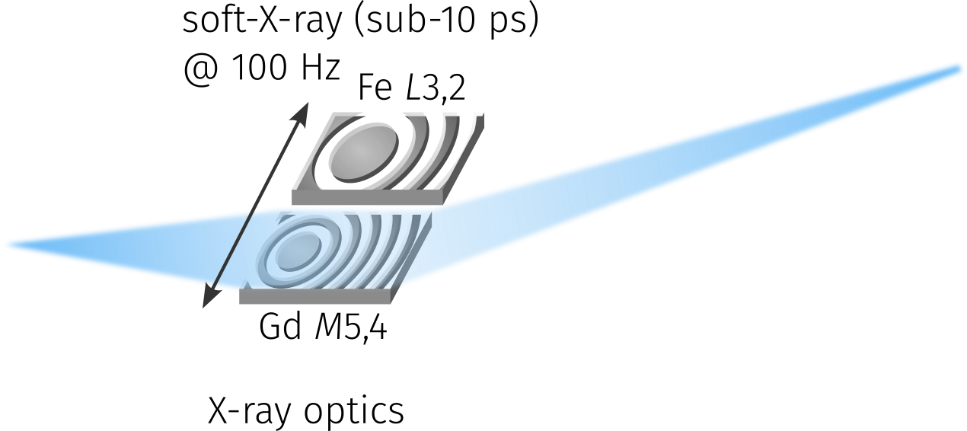
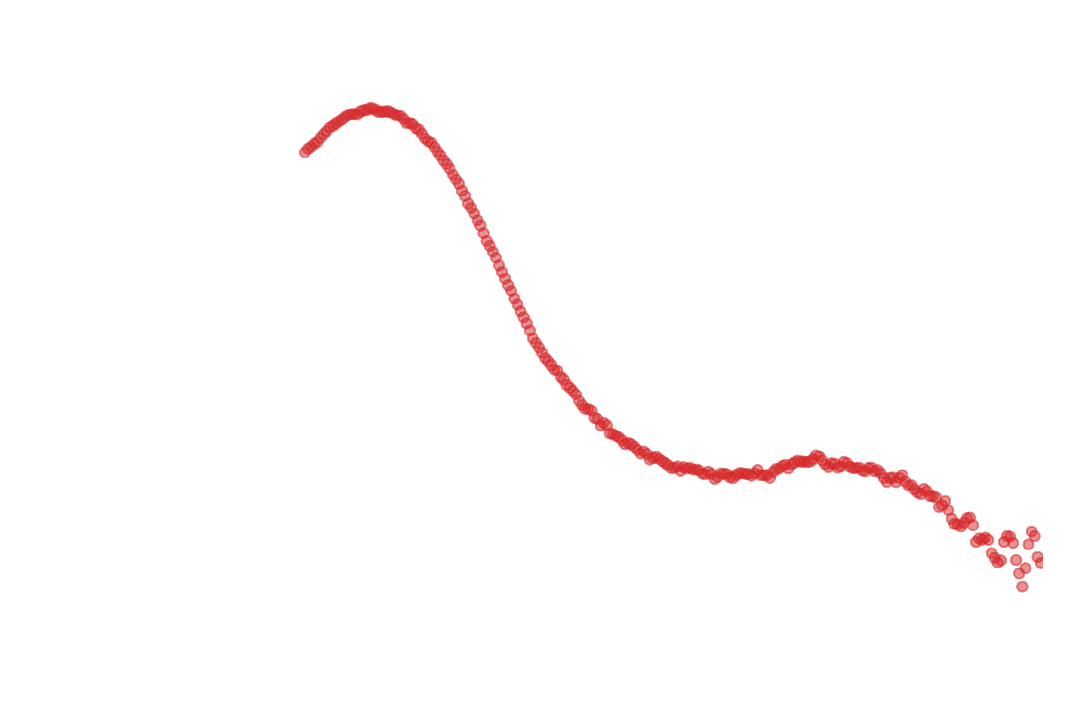
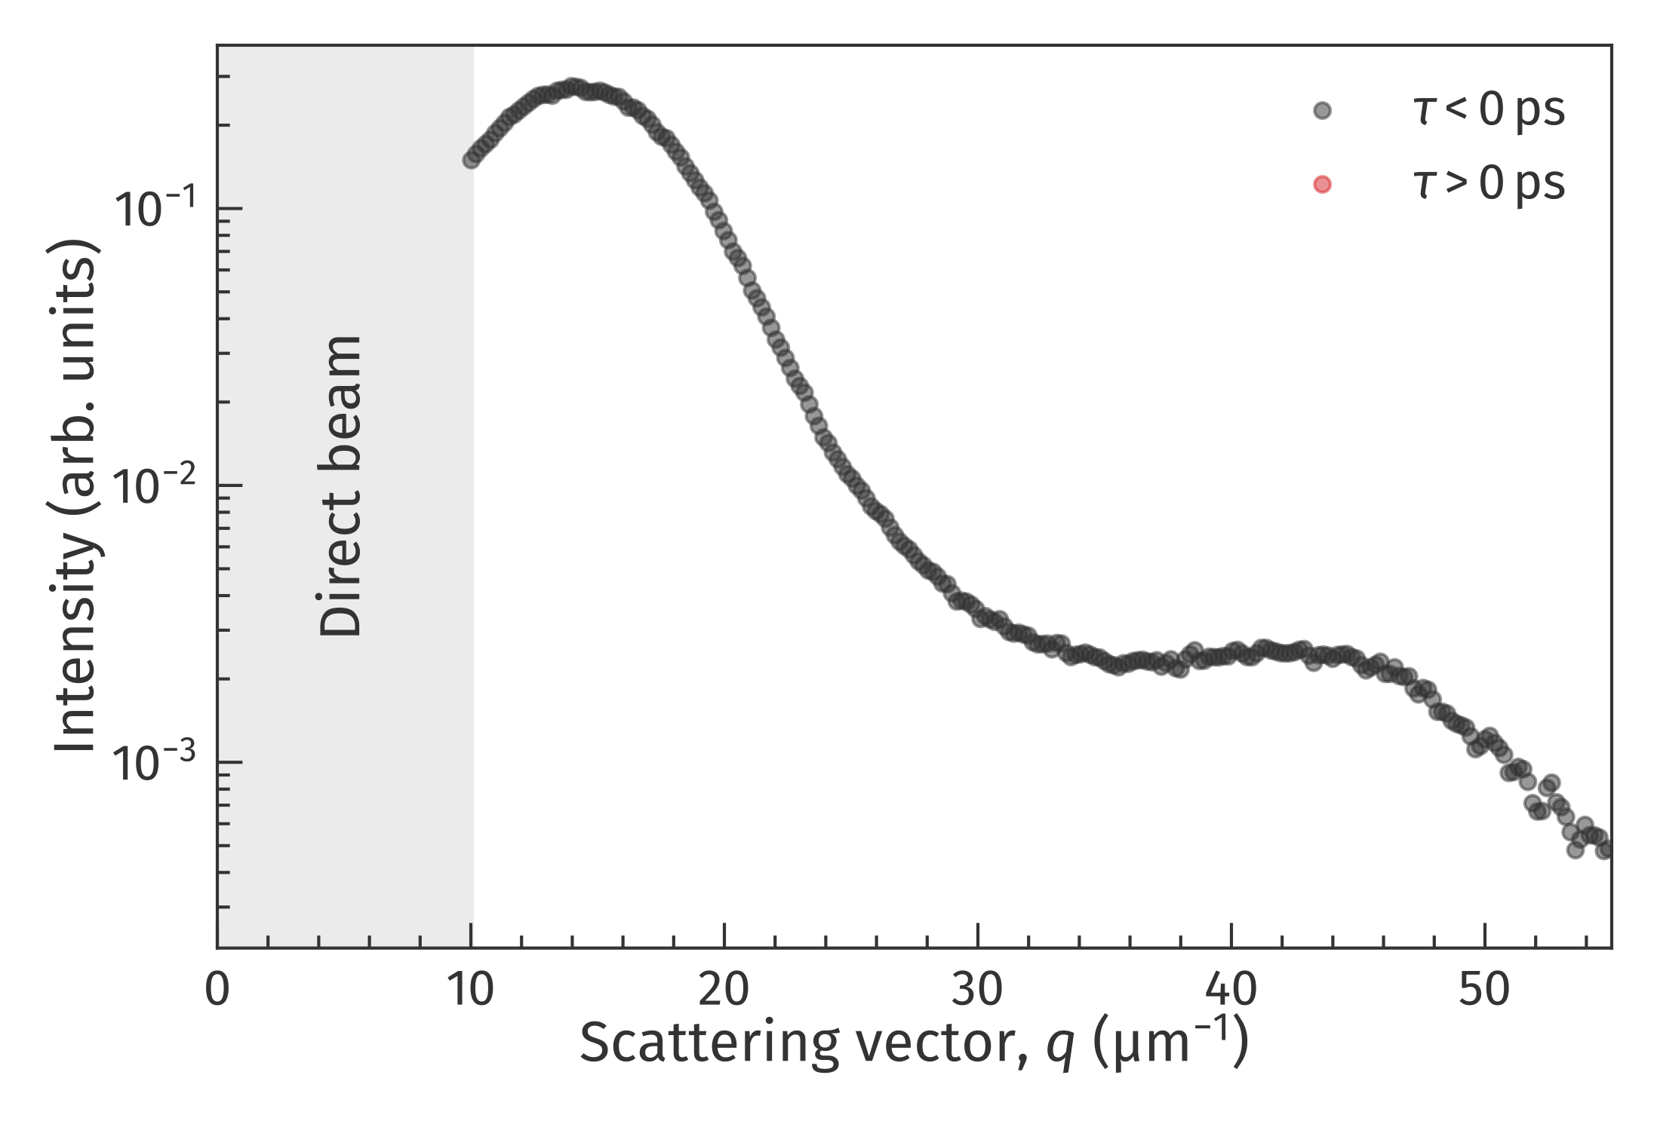
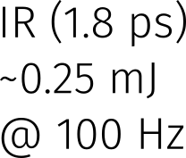
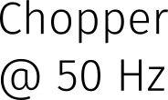
Experimental setup
Composite image
τ < 0
τ > 0
Calibrated source spectrum
1st
Detection features
Synchronized acquisition of each separate soft X-ray pulse
Single photon counting for each acquired frame
3rd
M. Borchert et al, Versatile tabletop setup for picosecond time-resolved resonant soft-x-ray scattering. Rev. Sci. Instrum. 1 June 2023; 94 (6): 063102.
M. Borchert et al, XMCD spectroscopy at the Fe L edges with a picosecond laser-driven plasma source, Optica 10, 450-455 (2023)
Notes:
We have a powerful pulsed infrared laser, which operates with 100 Hz, focused on tungsten cylinder inducing plasma. t radiates in broad spectra range in all directions.
As you can see it almost black-body radiation, so it is nothing but upscaled light bulb
Then we select the desired energy range, either for Gd or Fe, with the special X-ray optics.
And focus it on the sample.
And than acquire the scattered light with the hybrid detector. This detector is a prototype called MOENCH, made at PSI and it is capable to acquire each pulse individually. And the scattering pattern on the right builds up from these individual frames. There are only thousands of photons being focused on the sample in each frame and applying the photon finding algorithm only dozens scattered photons are detected. This, however, allows us not to block the direct beam, because the detector is not saturated.
Finally, we can add a pump beam with a chopper to our setup.
Then we use the chopper in a way that acquired frames alternate the from pumped and unpumped. We do it to get unpumped capture as a reference to the next pumped frame. On this composite image in the corner, you can see accumulated unpumped captures on the left and pumped on the right.
Taking the radial symmetry of the scattering patterns into account we further azimuthally integrate them and retrieve the radial intensity as function of scattering vector.
And with a more frames we can also observe not only the first scattering order but also the third.
Now we focus on the first scattering order.

Slide 4
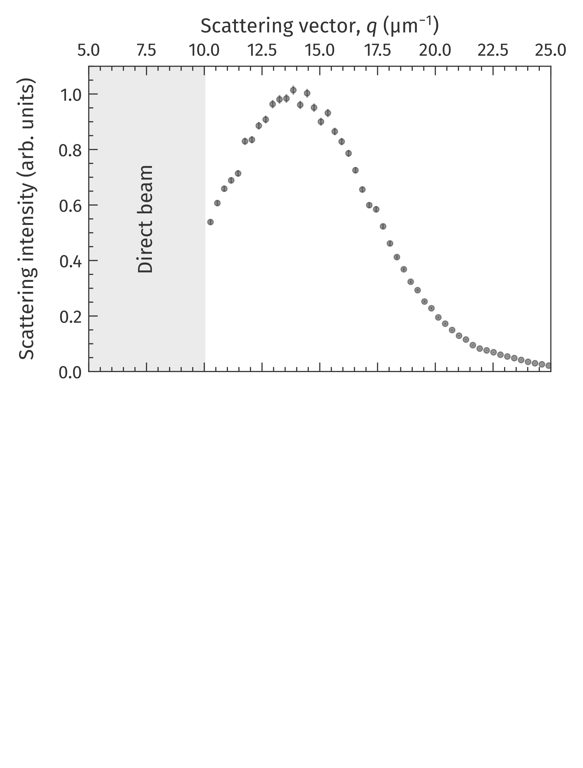
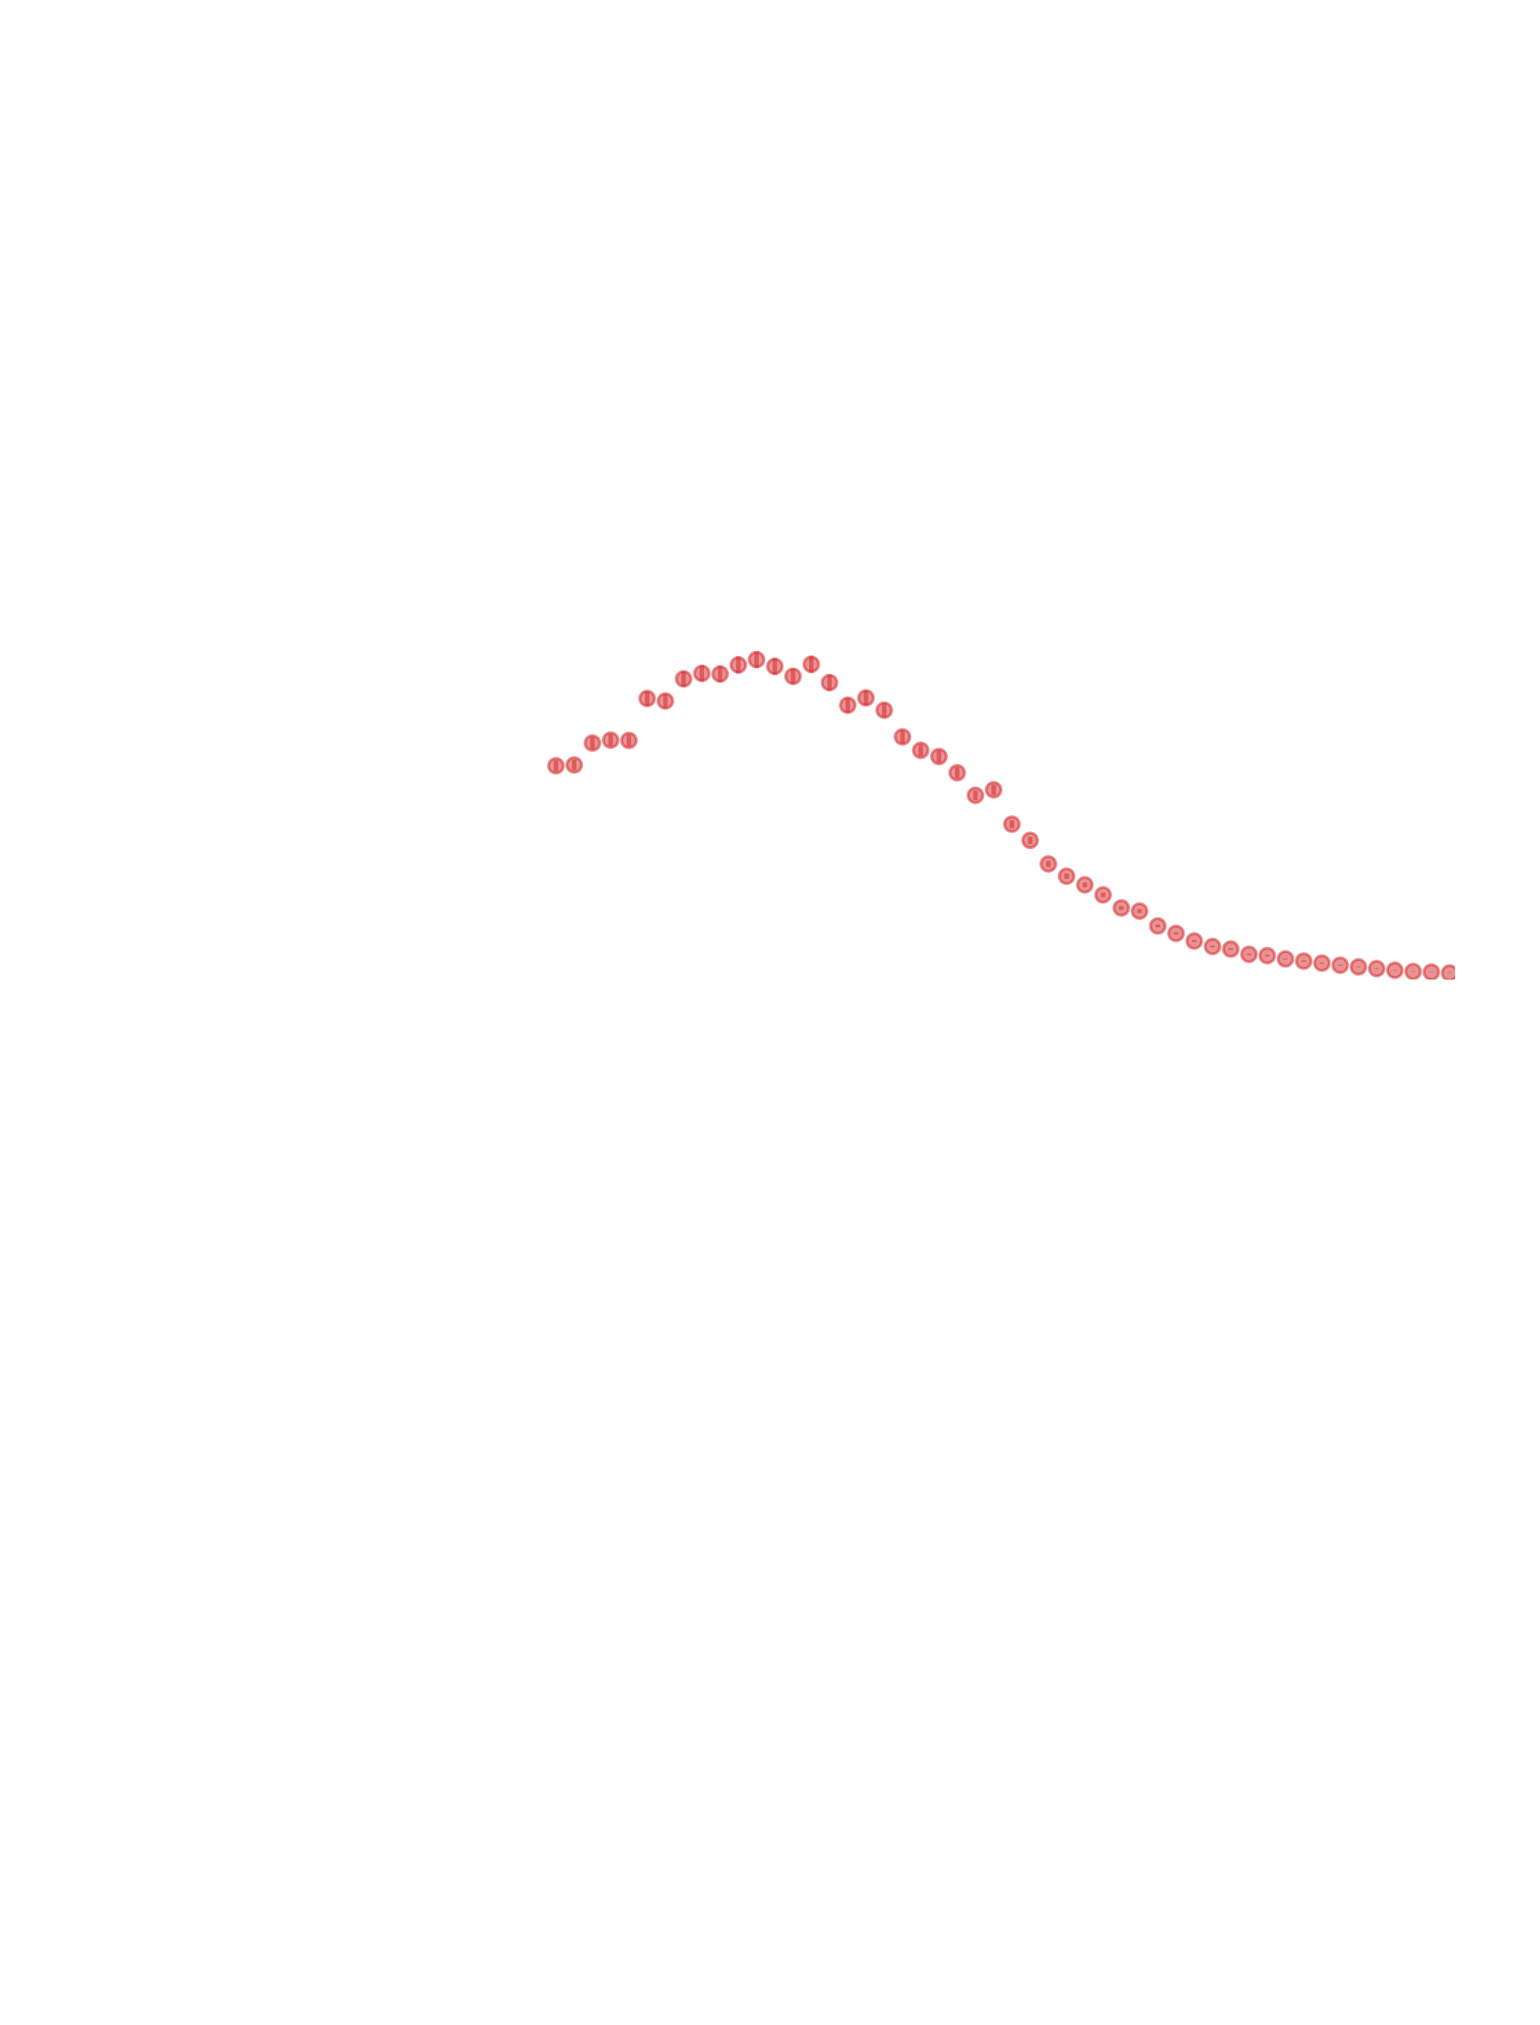
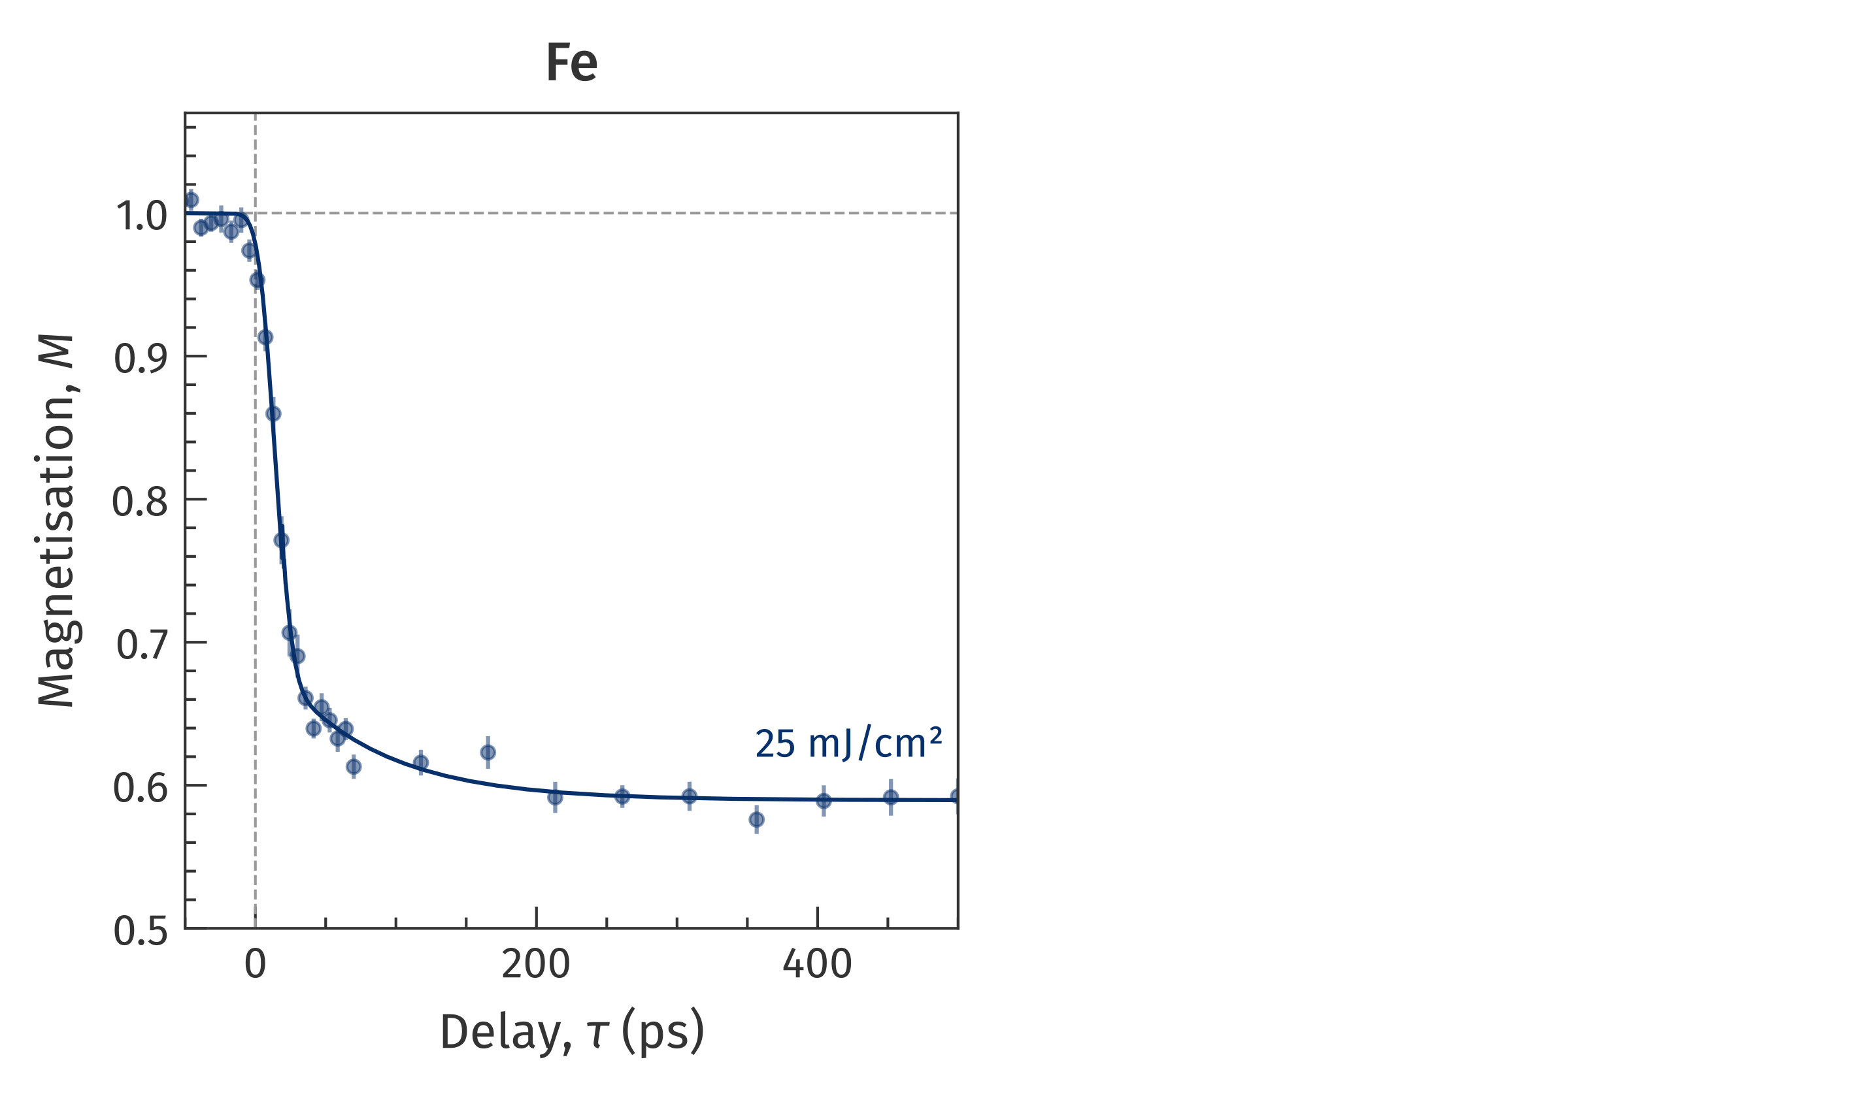
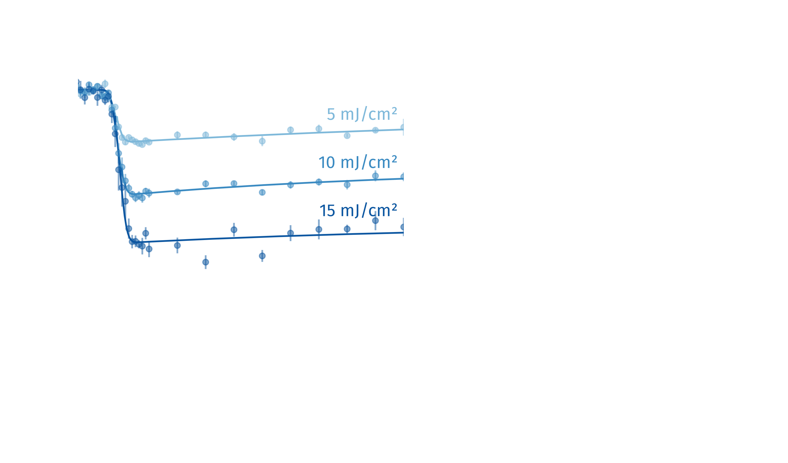
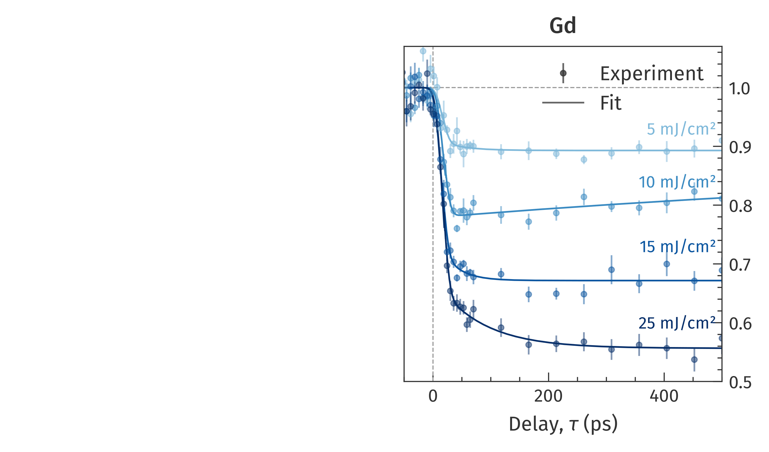
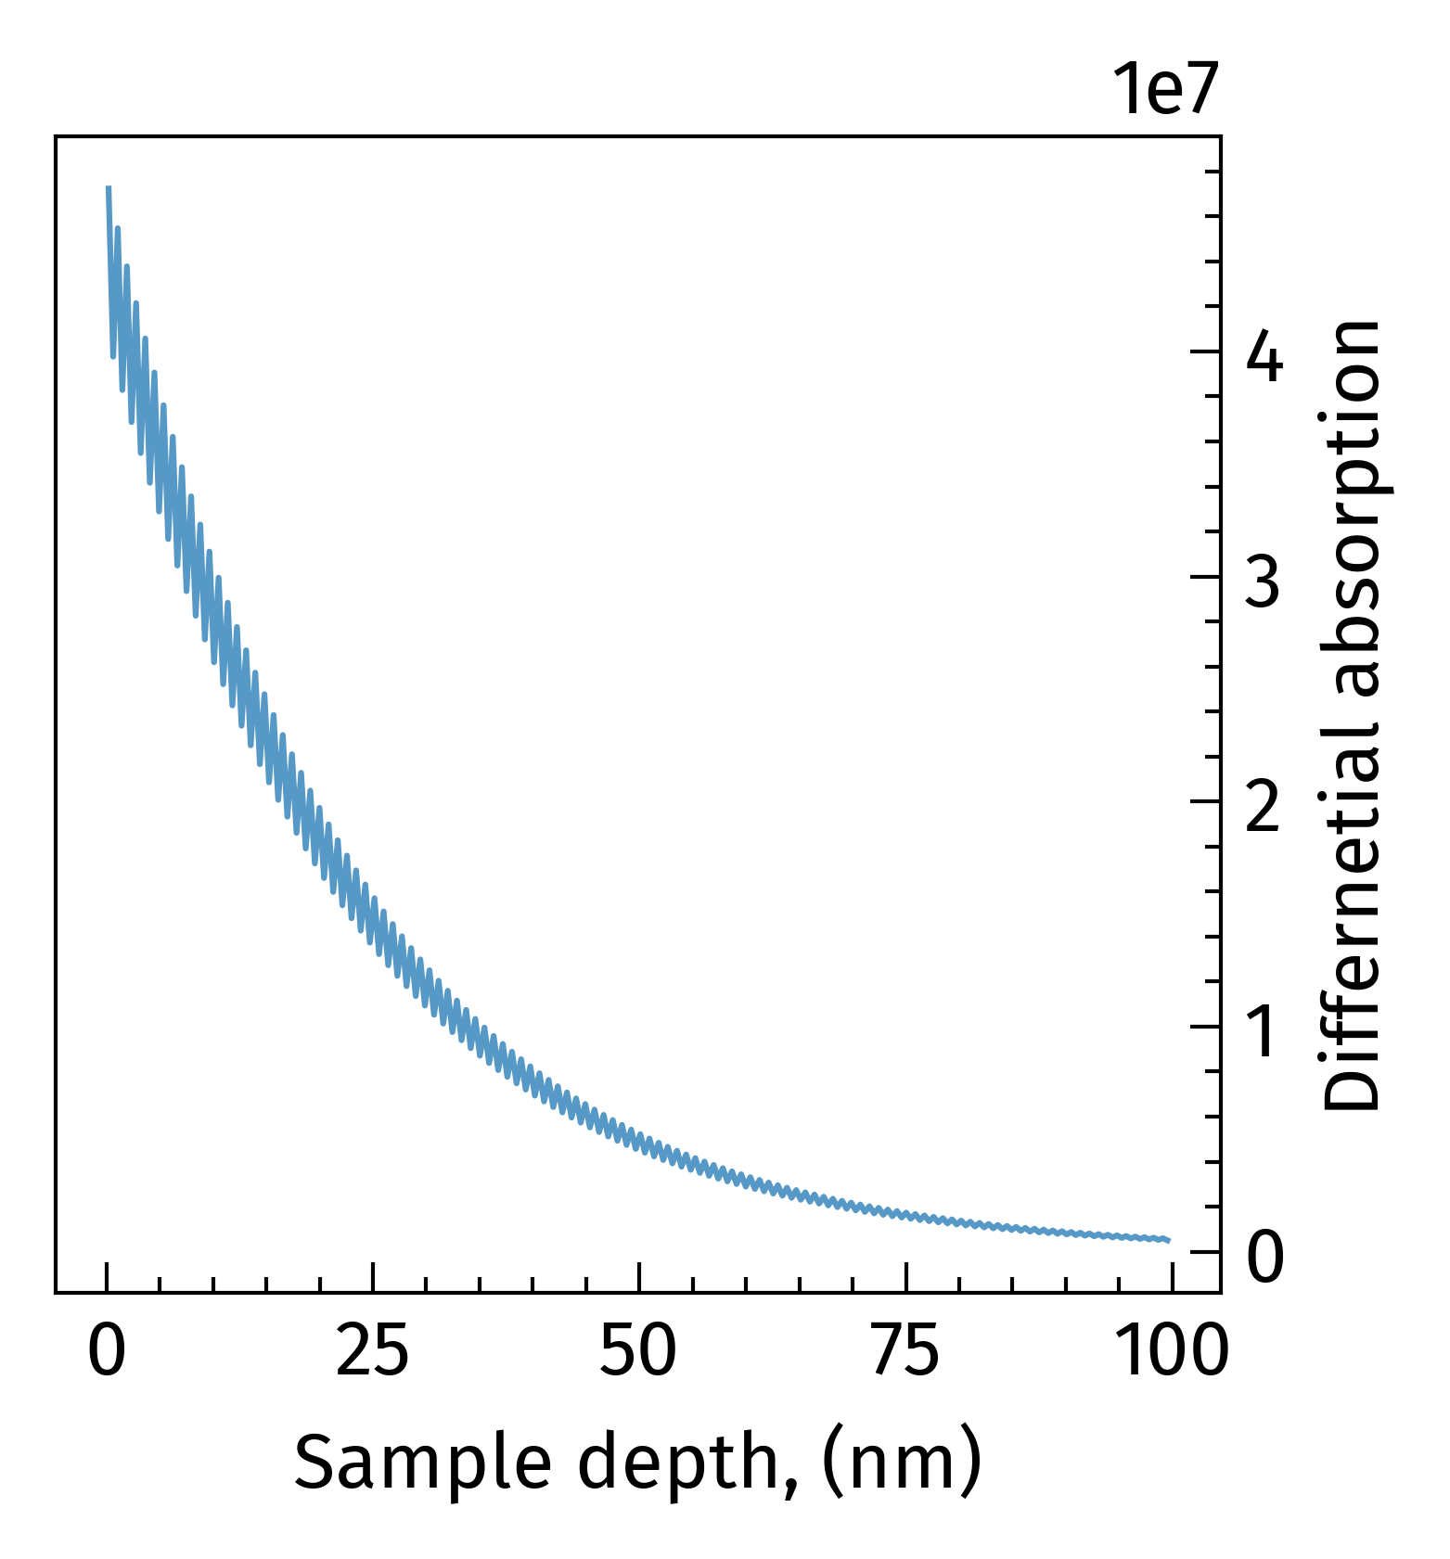
Time-resolved demagnetization
$M\left(τ\right)∝\sqrt{\int{I\left(q, τ\right) dq}}$
Demagnetization
$M\left(τ\right)∝\sqrt{\int{I\left(q, τ\right) dq}}$
Saturation at 60%
Linear fluence dependence
Similar behavior for Fe and Gd
Notes:
Now focusing on the first scattering order we apply the apply the fit-function firstly for unpumped data
Then do the same for pumped data.
The most oblivious difference to see that integrated intensity of pumped image has decreased relatively to the unpumped reference.
Retrieving the magnetization as a square root of the scattering intensity we can observe a rapid drop upon a photo-excitation where the electrons are heated, magnetic order is temporally destroyed, and magnetic contrast disappear.
The strongest demagnetization we could achieve saturates at 60%. The reason for it can be significant thickness of the sample. The performed simulation shows that the bottom layers are exposed to much lower fluence than top.
And since the experiment is done in the transmission geometry, we observe the information averaged along the sample’s depth.
Than, we measured the data for different pump fluence observing a good linear dependence from the fluence.
And do it for gadolinium as well.

Slide 5
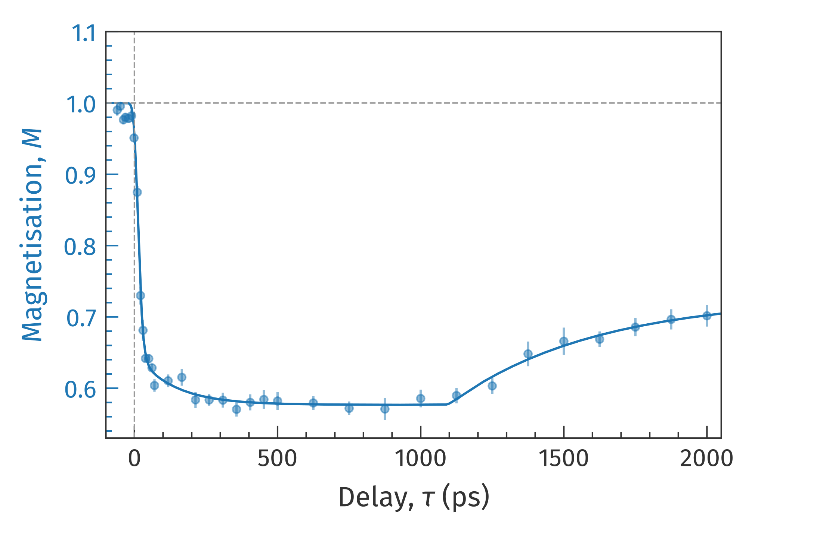
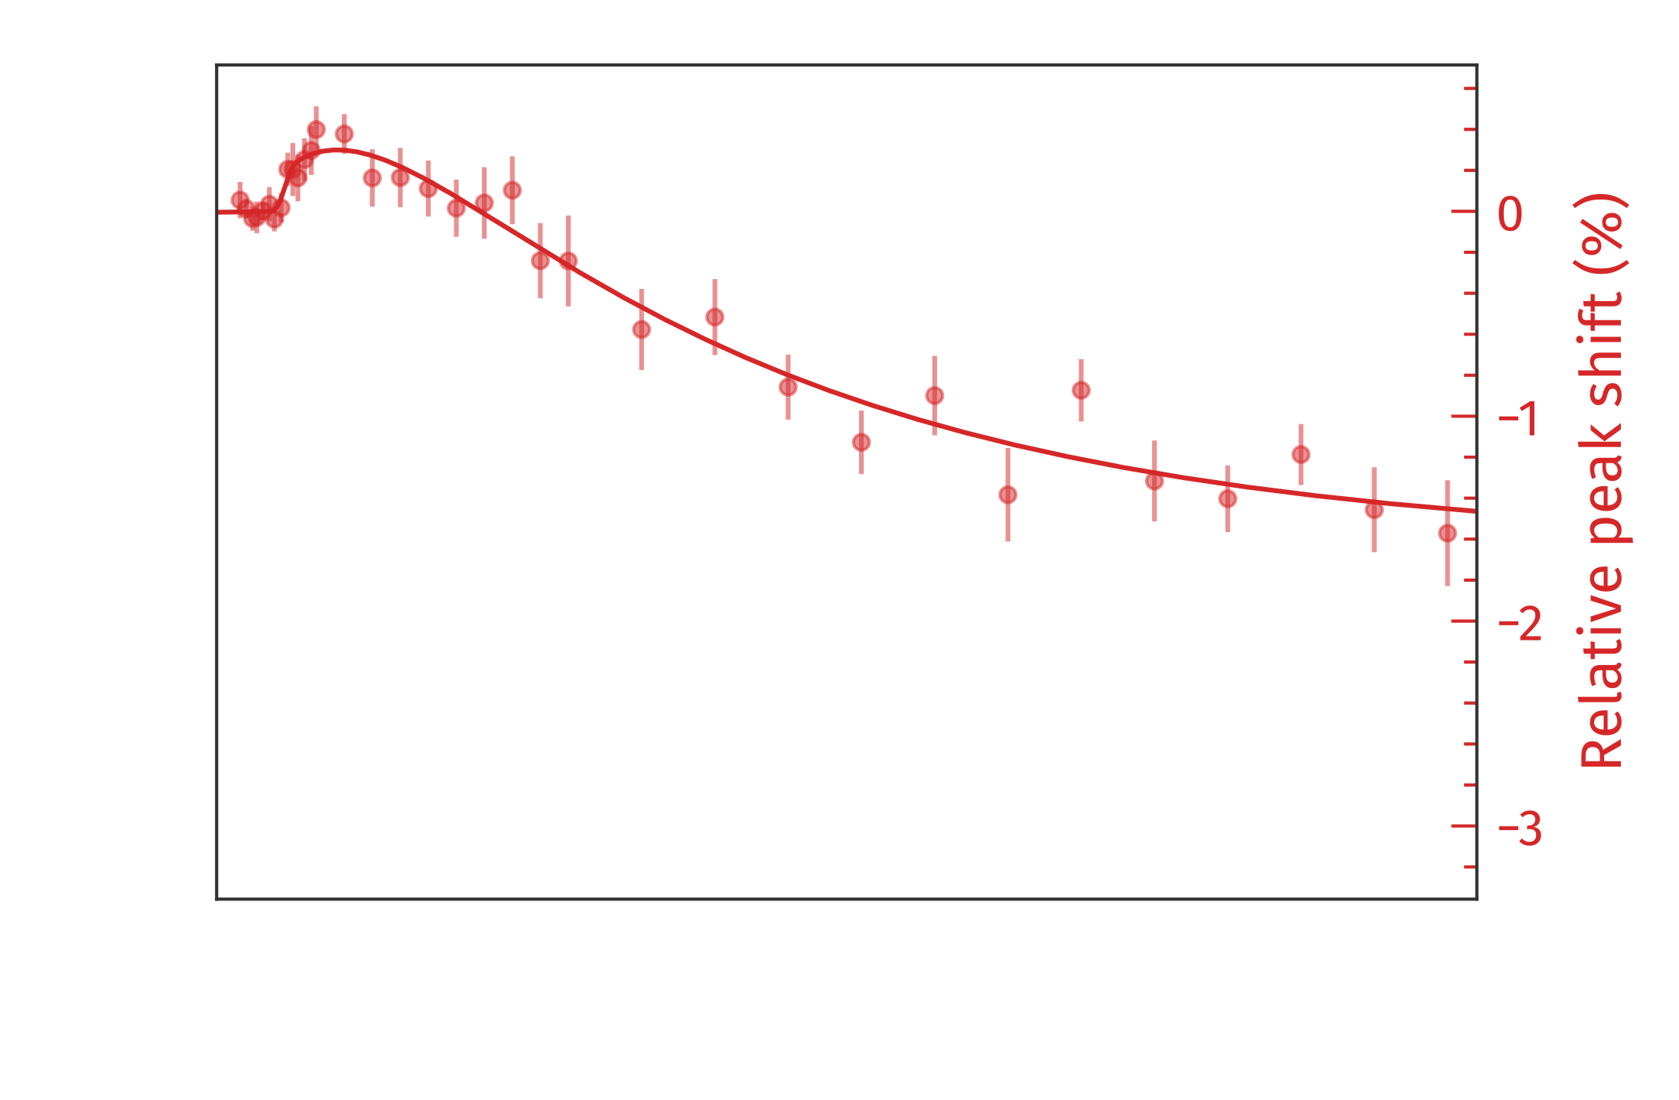
Time-resolved peak shift
Fe, 25 mJ/cm²
Peak shift
Different timescale to demagnetization
Bipolar behavior
Notes:
Then we continued our measurement to longer delays.
What else can we do with the measured data. Let’s look on the position of the maxima of distribution.
This would mean the change of ring radius what corresponds to change of average domain size.
Then we evaluated this data for the whole delay range. What we can see that this effect has a different timescale with demagnetization effect and shows both increase and decrease of ring size.
Let’s take a more precise look.

Slide 6
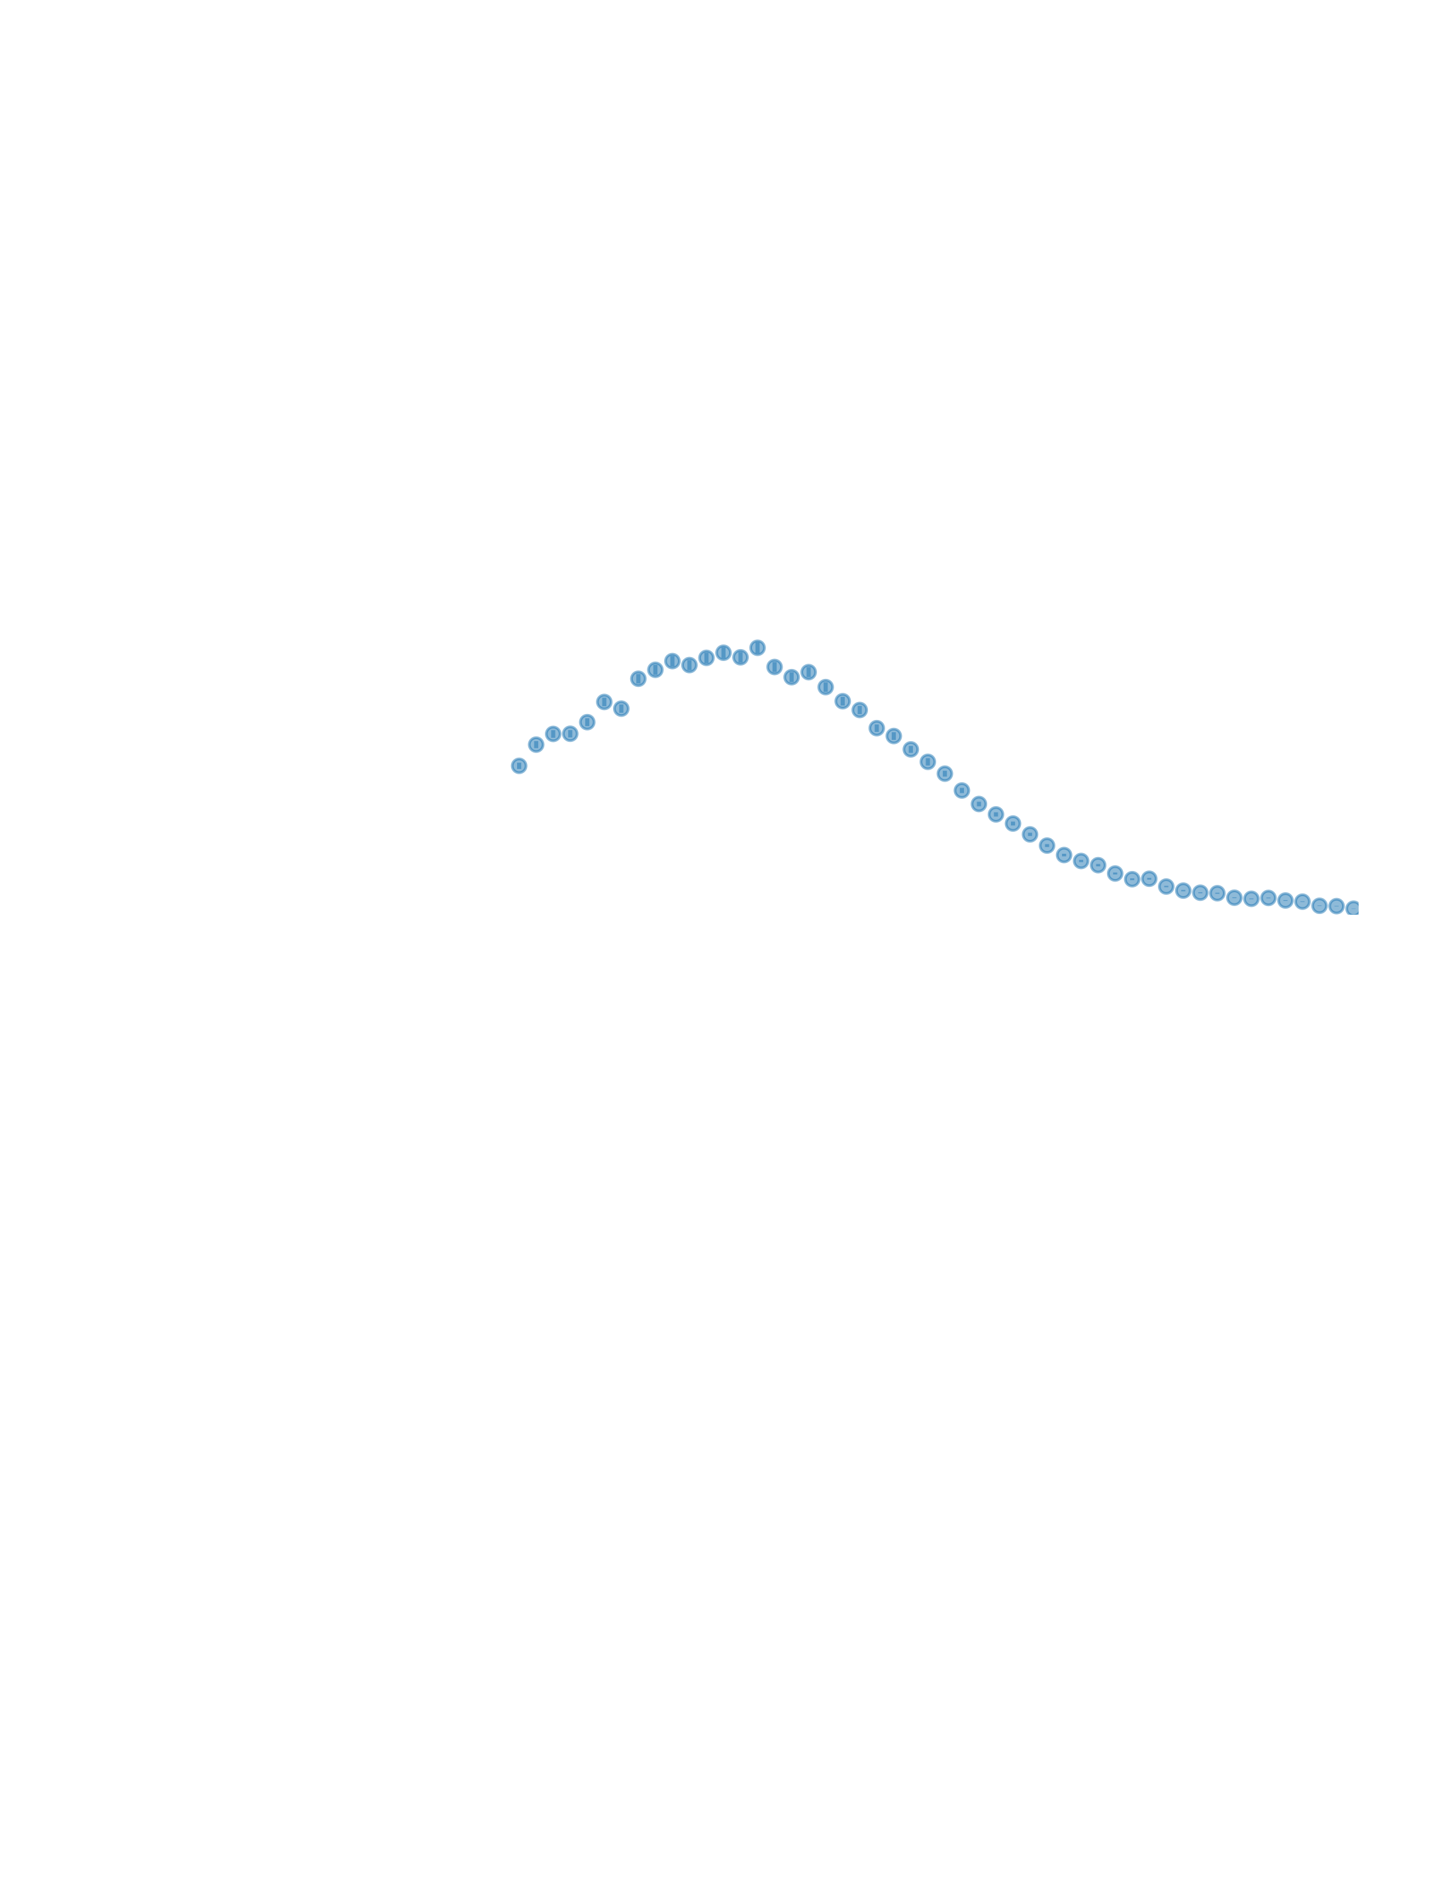
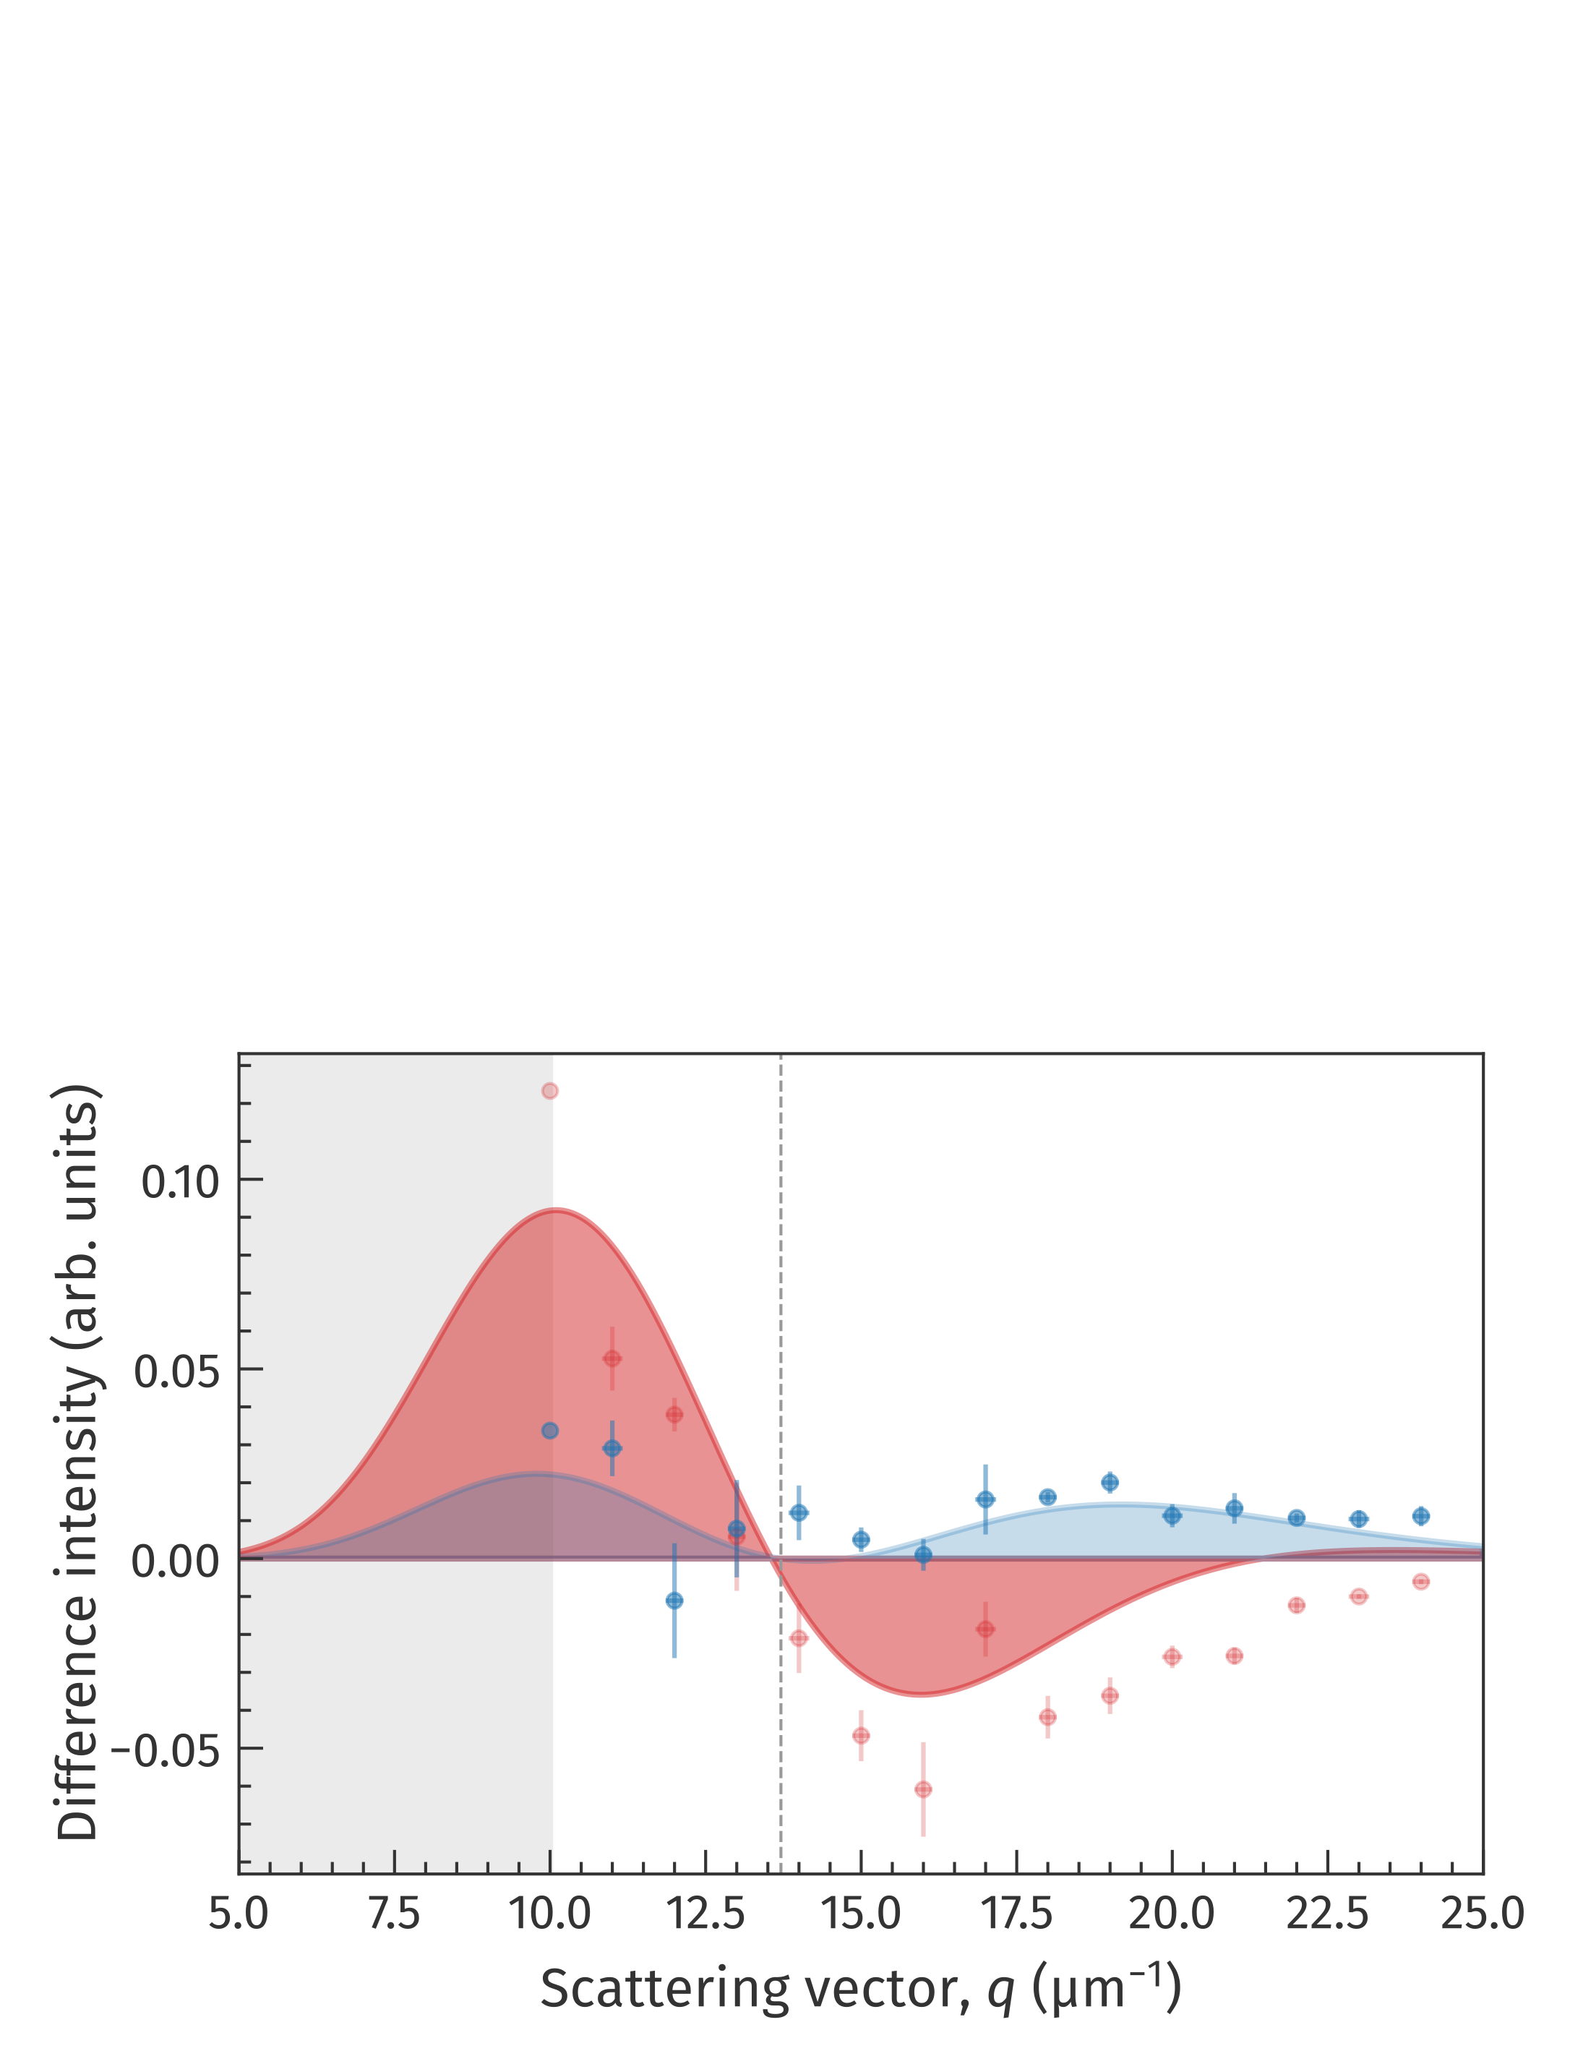
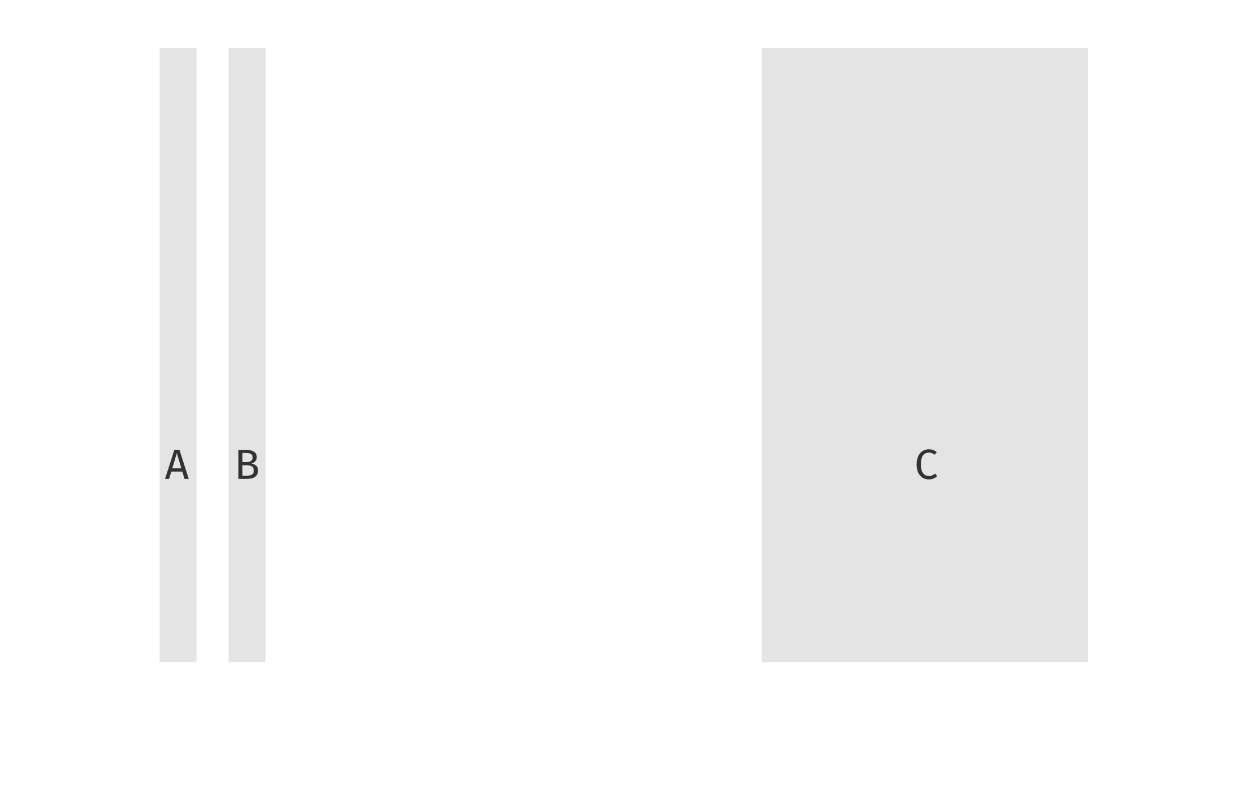
Time-resolved peak shift
Fe, 25 mJ/cm²
Peak shift
Positive shift and peak broadening right after excitation
Negative shift at longer timescales
Notes:
Now we consider these three time intervals and radial intensity distributions. The blue one corresponds to the time interval right after the laser excitation. Now we normalize all these peak intensities and plot the difference of the blue and red peak with an unpumped reference.
The difference for red peak shows a negative shift, while the area on the left side increases and decreases on right side.
The behavior of blue peak is much more interesting and complex. The area increases on both sides of unpumped peak center. This means that the peak is getting wider. But area on the right side is greater than on left, so the peak shifts towards higher scattering vectors.
The broadening of the ring width among the increase of the radius means that the variance of domain sizes getting bigger. This effect can be also associated with the significant sample thickness and propagation of the heat along the sample depth in time.

Slide 7
Summary
Composite image
Time-resolved magnetic SAXS
First lab-based setup
Superb SNR within the minutes
High resolution in reciprocal space
Element selective measurements
X-ray optics for Fe, Gd, Dy, Co edges
High setup flexibility
Up to 10 ms pump delay with sub-10 ps time-resolution
Temperature & magnetic field
Variable photo-excitation in pulse length and wavelength
τ < 0
τ > 0
N. Schneider, Master’s Thesis, 2024,
L. Lunin & M. Borchert et al, in preparation

Slide 8
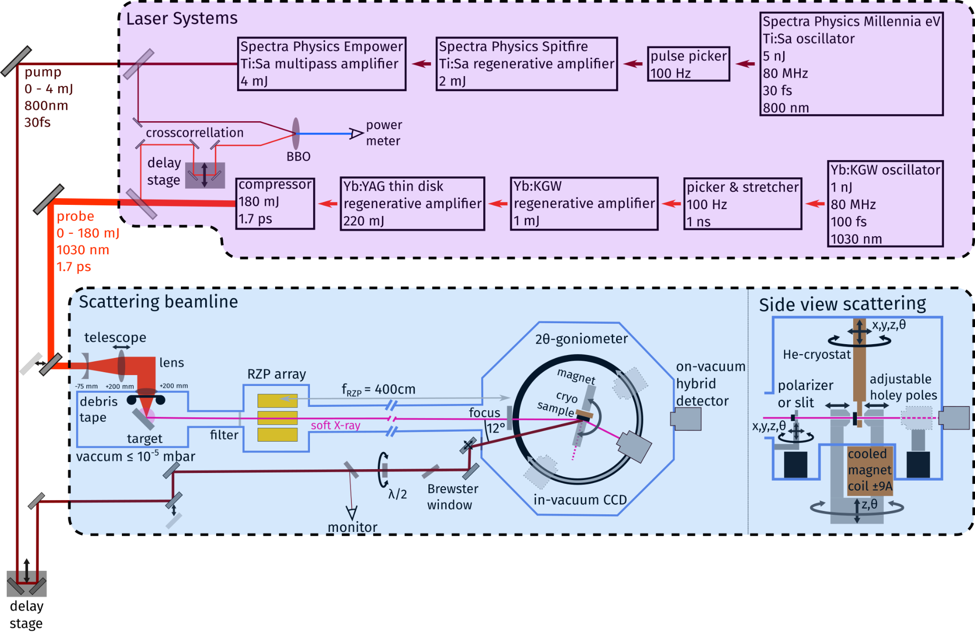
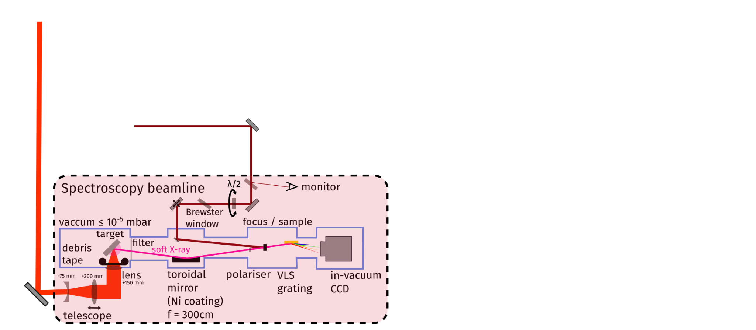
Conclusion
Thank you for attention and our research group

